Slide 1
Structured Programming Language
Nahidul Islam
Lecturer, Dept. of CSE
DCC, Dhaka.
1/31/2023
1

Slide 2
Control Statement
2

Slide 3
Branching
THE if STATEMENT
Syntax:
if (expression)
statement
The expression must be placed in parentheses, as shown. In this form, the statement will be executed only if the expression has a nonzero value (i.e., if expression is true). If the expression has a value of zero (i.e., if expression is false), then the statement will be ignored.
The statement can be either simple or compound.
Example : 1) if( x < 0)
printf ( "%f” , x ) ;
2) if (x <= 3.0) {
y = 3 * pow(x, 2 ) ;
printf ( “The output is: %f\n", y) ;
}
3

Slide 4
Branching
If statement example:
#include<stdio.h>
int main(){
int number=0;
printf("Enter a number:");
scanf("%d",&number);
if(number%2==0){
printf("%d is even number",number); 8. }
9. return 0; 10.}
Output:
Enter a number:4 4 is even number
4

Slide 5
#include <stdio.h>
int main()
3.{
int a, b, c;
printf("Enter three numbers?");
6. scanf("%d %d %d",&a,&b,&c);
7. if(a>b && a>c)
8. {
9. printf("%d is largest",a);
10. }
11. if(b>a && b > c)
12. {
13. printf("%d is largest",b);
14. }
15. if(c>a && c>b)
16. {
17. printf("%d is largest",c);
18. }
19. if(a == b && a == c)
20. {
21. printf("All are equal");
22. }
23.}
Program to find the largest number of the three.
Enter three numbers? 12 23 34
34 is largest
5

Slide 6
Branching
THE if - else STATEMENT Syntax:
if (expression)
statement 1 else
statement 2
If the expression has a nonzero value (i.e., if expression is true), then statement1 will be executed. Otherwise (i.e., if expression is false), statement2 will be executed.
Example: if (x <= 3)
y = 3 * pow(x, 2 ) ;
else
y = 2 * pow((x - 3 ) , 2 ) ;
6

Slide 7
Branching
If-else statement example
#include<stdio.h>
int main(){
int number=0;
printf("enter a number:");
scanf("%d",&number);
if(number%2==0){
printf("%d is even number",number); 8. }
9. else{
0. printf("%d is odd number",number); 1. }
2. return 0; 3.}
Output:
enter a number: 4 4 is even number
enter a number: 5 5 is odd number
7

Slide 8
Branching
THE if - else if – else STATEMENT Syntax:
if (expression1)
statement 1 else if (expression2)
statement 2
else if (expression3) statement 3
else
statement 4
8

Slide 9
Branching
if - else if – else Example:
#include <stdio.h> int main ()
{
int x,y;
printf ("\nInput an integer value for x: "); scanf ("%d", &x);
printf ("\nInput an integer value for y: "); scanf ("%d",&y);
if (x==y)
printf ("x is equal to y\n"); else if (x > y)
printf ("x is greater than y\n");
else
printf ("x is smaller than y\n"); return 0;
}
9

Slide 10
#include<stdio.h>
int main(){
int number=0;
printf("enter a number:");
scanf("%d",&number);
if(number==10){
printf("number is equals to 10"); 8. }
9. else if(number==50){
0. printf("number is equal to 50"); 1. }
else if(number==100){
printf("number is equal to 100"); 4. }
else{
printf("number is not equal to 10, 50 or 100"); 7. }
8. return 0; 9.}
Output:
enter a number: 4 number is not equal to 10, 50 or 100
enter a number: 50 number is equal to 50
10

Slide 11
#include <stdio.h>
int main()
3.{
int marks;
printf("Enter your marks?");
scanf("%d",&marks);
if(marks > 85 && marks <= 100)
8. {
9. printf("Congrats ! you scored grade A ...");
Program to calculate the grade of the student according to the specified marks
Output:
Enter your marks? 10 Sorry you are fail ...
Enter your marks? 40 You scored grade C ...
Enter your marks? 90
Congrats ! you scored grade A ...
10. }
11. else if (marks > 60 && marks <= 85)
12. {
13. printf("You scored grade B + ...");
14. }
15. else if (marks > 40 && marks <= 60)
16. {
17. printf("You scored grade B ...");
18. }
19. else if (marks > 30 && marks <= 40)
20. {
21. printf("You scored grade C ...");
22. }
23. else
24. {
25. printf("Sorry you are fail ...");
26. }
27.}
11

Slide 12
Branching
Nested if statement- Syntax:
if e1 {
if e2 s1
}
else s2
12

Slide 13
#include <stdio.h>
int main() {
int number1, number2; printf("Enter two integers: ");
scanf("%d %d", &number1, &number2); if (number1 >= number2) {
if (number1 == number2) {
Nested If statement example
printf("Result: %d = %d",number1,number2);
}
else {
printf("Result: %d > %d", number1, number2);
}
}
else {
printf("Result: %d < %d",number1, number2);
13
}

Slide 14
LOOPING : THE while STATEMENT
THE while STATEMENT
The while statement is used to carry out looping operations, in which a group of statements is executed repeatedly, until some condition has been satisfied.
Syntax:
while ( expression)
statement
The statement will be executed repeatedly, as long as the expression is true (i.e., as long expression has a nonzero value). This statement can be simple or compound, though it is usually a compound statement.

Slide 15
LOOPING : THE while STATEMENT
While statement example1:
Suppose we want to display the consecutive digits 0, 1, 2, . . . ,9, with one digit on each line. This can be accomplished with the following program.
/* display the integers 0 through 9 */ #include <stdio.h>
main ( )
{
int digit = 0;
while (digit <= 9) {
printf ( "%d\n", digit) ;
++digit;
}
}
Output: 0
1
2
3
4
5
6
7
8
9

Slide 16
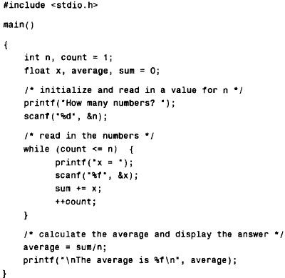
LOOPING : THE while STATEMENT
While statement example 2 : Averaging list of numbers

Slide 17
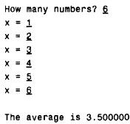
LOOPING : THE while STATEMENT
While statement example2 :
Output of previous slide program

Slide 18
LOOPING : THE do-while STATEMENT
Syntax:
do
statement
while (expression);
The statement will be executed repeatedly, as long as the value of expression is true (i.e., is nonzero).
Notice that statement will always be executed at least once, since the test for repetition does not occur until the end of the first pass through the loop.
What is the difference between while and do-while ?

Slide 19
LOOPING : THE do-while STATEMENT
Consecutive Integer Quantities
/* display the integers 0 through 9 */ #include <stdio.h>
main ( )
{
int digit = 0; do {
printf ( "%d\n", digit++) ;
}
while (digit <= 9);
}
Output: 0
1
2
3
4
5
6
7
8
9

Slide 20
LOOPING: THE for STATEMENT
Syntax:
for ( expression 1; expression 2; expression 3)
{
statement
}
where expression 1 is used to initialize some parameter (called an index) that controls the looping action.
Expression 2 represents a condition that must be true for the loop to continue execution.
Expression3 is used to alter the value of the parameter initially assigned by expression 1. Typically, expression 1 is an assignment expression, expression 2 is a logical expression and expression 3 is a unary expression or an assignment expression.

Slide 21
LOOPING: THE for STATEMENT
Consecutive Integer Quantities
/* display the numbers 0 through 9 */ #include <stdio.h>
main()
{
int digit;
for (digit = 0; digit <= 9; ++digit) printf(’%d\n”, digit);
}

Slide 22
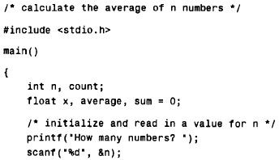
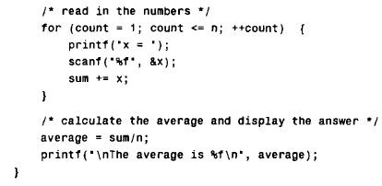
LOOPING: THE for STATEMENT
Averaging a list of numbers

Slide 23
Nested Loops in C
Any number of loops can be defined inside another loop, i.e., there is no restriction for defining any number of loops. The nesting level can be defined at n times.
1.Outer_loop
1.for (initialization; condition; update) 2.{
2.{
3. | Inner_loop | 3. | for(initialization; condition; update)
4. | { | 4. | {
5. | // inner loop statements. | 5. | // inner loop statements.
6. | } | 6. | }
7. 8.} | // outer loop statements. | 7. 8.} | // outer loop statements.

Slide 24
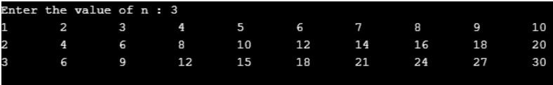
1.#include <stdio.h>
2.int main() 3.{
int n;// variable declaration
printf("Enter the value of n :");
6. scanf(“%d”, &n);
7. for(int i=1;i<=n;i++) // outer loop 8. {
9. for(int j=1;j<=10;j++) // inner loop 0. {
1. printf("%d\t",(i*j)); // printing the value. 2. }
3. printf("\n"); 4. }
Nested Loops in C

Slide 25
Infinite Loop in C
An infinite loop is a looping construct that does not terminate the loop and executes the loop forever. It is also called an indefinite loop.
#include <stdio.h>
int main() 3.{
1.for(; ;) 2.{
3. // body of the for loop. 4.}
4. for(;;)
5. {
6. printf("Hello CSE"); 7. }
8.return 0;
9.}

Slide 26
Infinite Loop in C
#include <stdio.h>
int main() 3.{
int i=0;
while(1) 6. {
1.while(1) 2.{
3. // body of the loop.. 4.}
7. i++;
8. printf("i is :%d",i); 9. }
1.do
2.{
3. // body of the loop.. 4.}while(1);
10.return 0;
11.}

Slide 27
Thank you

